Slide 1
CH- X SECONDARY FIBERS & RECYCLING

Slide 2
A. INTRODUCTION
In the perspective of history, past societies have not managed their natural resources well.
As standards of living increase, the demand on our natural resources rises at an ever increasing rate. Papermaking fiber is no exception.
Luckily, cellulosic fiber can be recycled many times over as evidenced by the fact that most Western paper originally was made from rags, specifically cotton rags.
With a tradition of making new paper from society’s discards, it is not surprising that the deinking of waste paper to recover cellulose fiber became an established technology not too many years after the invention of the groundwood, sulfite and kraft pulp manufacturing processes.

Slide 3
The extent to which the reuse or recycling of resources is practiced depends upon the extent and cost of resources available in a country.
Aside from periods of national emergencies, such as wars, the more resource rich a country is the less it will practice recycling.
Information collected by various government agencies shows relatively typical waste paper recovery rates in various industrialized countries around the world (Fig. 44).

Slide 4
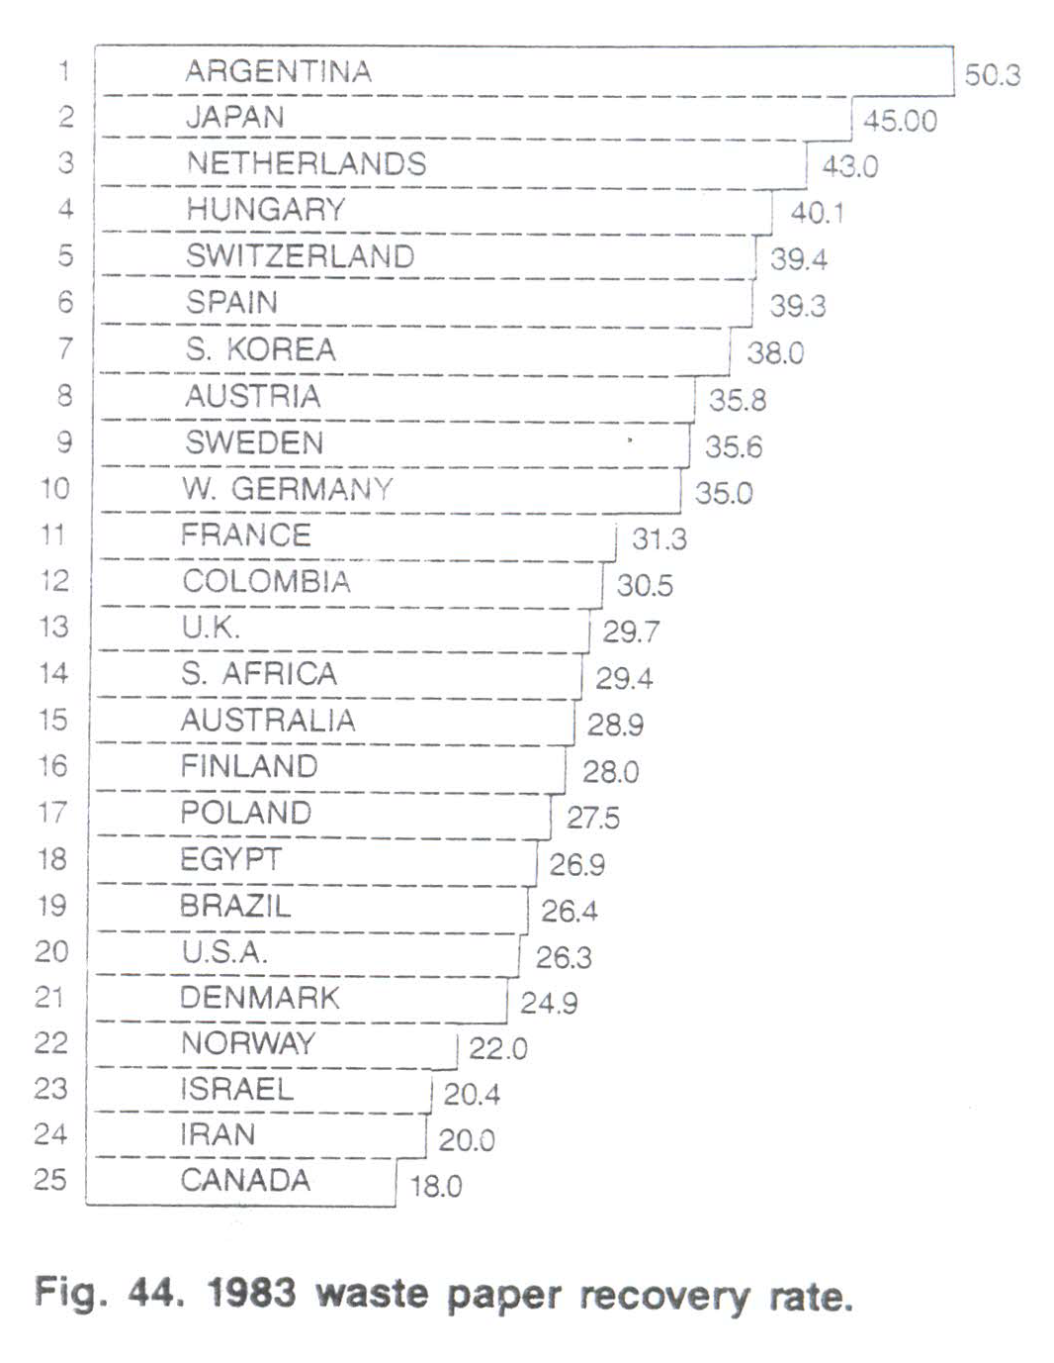

Slide 5
Competitive pressures starting not too long after World War II made the consumer more and more quality conscious, eventually putting pressure on the use of the word 'waste' in connection with a raw material for paper products.
As we entered the age of efficient economies , energy shortages and greatly heightened environmental concern, many institutional factors began to influence the thinking about the recycling of cellulose fiber.
TAPPI's deinking committee officially changed its name in 1967 to Secondary Fiber Pulping Committee, primarily to recognize the broadly diversifying uses of paper and board which had once served its intended purpose.

Slide 6
Waste paper , secondary fiber and post-consumer waste are synonymous in many respects, but have different connotations in their users' minds.
Some uses had, and again many have, tax and cost incentives from regulatory governmental agencies.
Secondary fiber from the technical and mill operations point of view, represents paper or paper board which is being sent to a different paper mill for reuse.

Slide 7
Broke, trim and rejects being put back into the manufacturing process at their original place of manufacture are not considered secondary fiber.
The term post-consumer waste is generally associated with grades of secondary fiber which have seen use in various household and commercial applications.
All secondary fibers share a common distinction of carrying some content of foreign material , such as ink or coatings ; outright contamination from all kinds of trash, even if in small quantities, such as rubber bands and paper clips ; and thermoplastic materials such as adhesives, binders and a variety of pressure-sensitive materials.

Slide 8
The processing of secondary fiber is primarily concerned with the removal of contaminating materials prior to reuse of the cellulose fiber. Depending upon the processing, the physical properties of secondary fiber will be altered by varying degrees.
Both the strength of individual fibers and the bonding between fibers decrease with recycling , as shown in Fig. 45A and B.

Slide 9
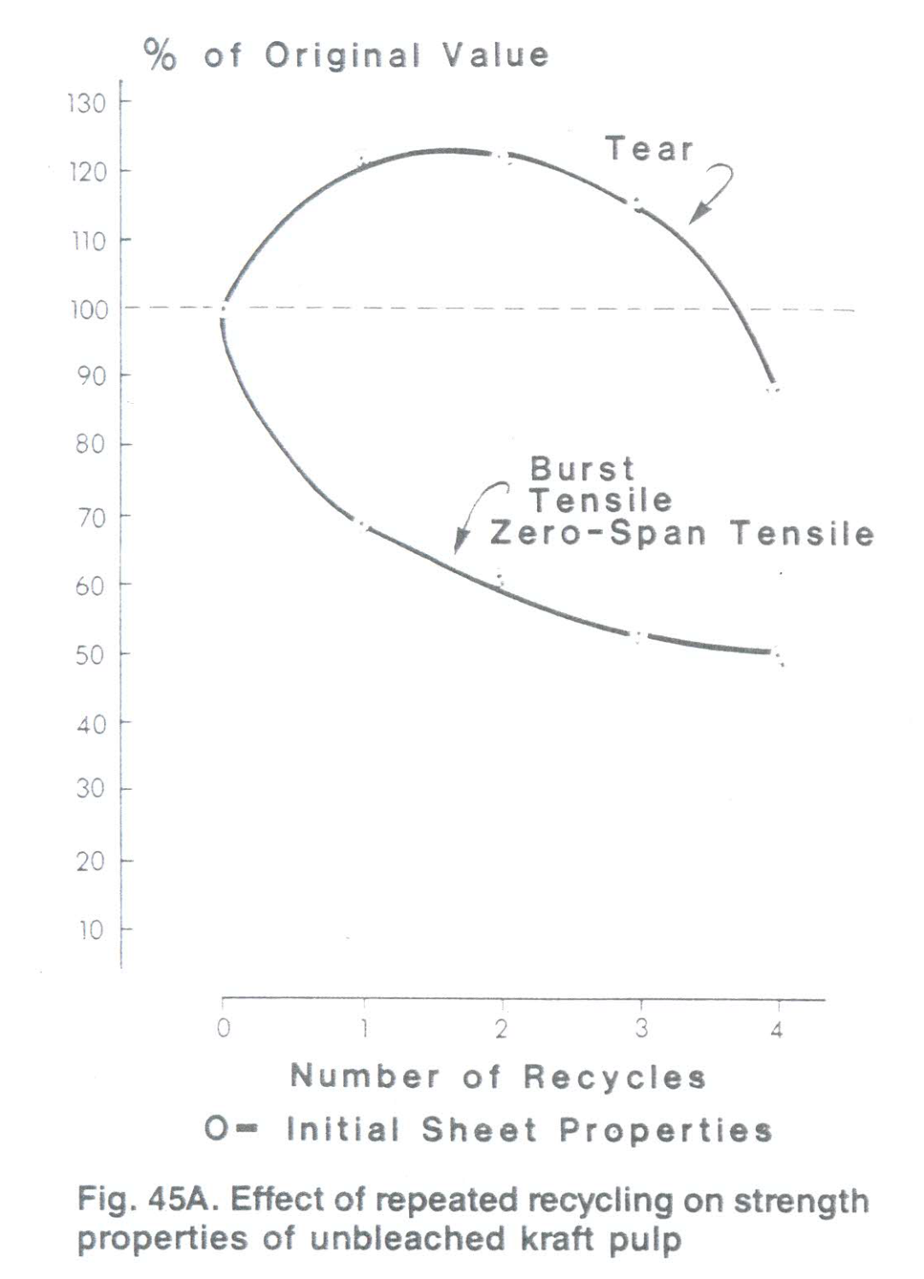

Slide 10
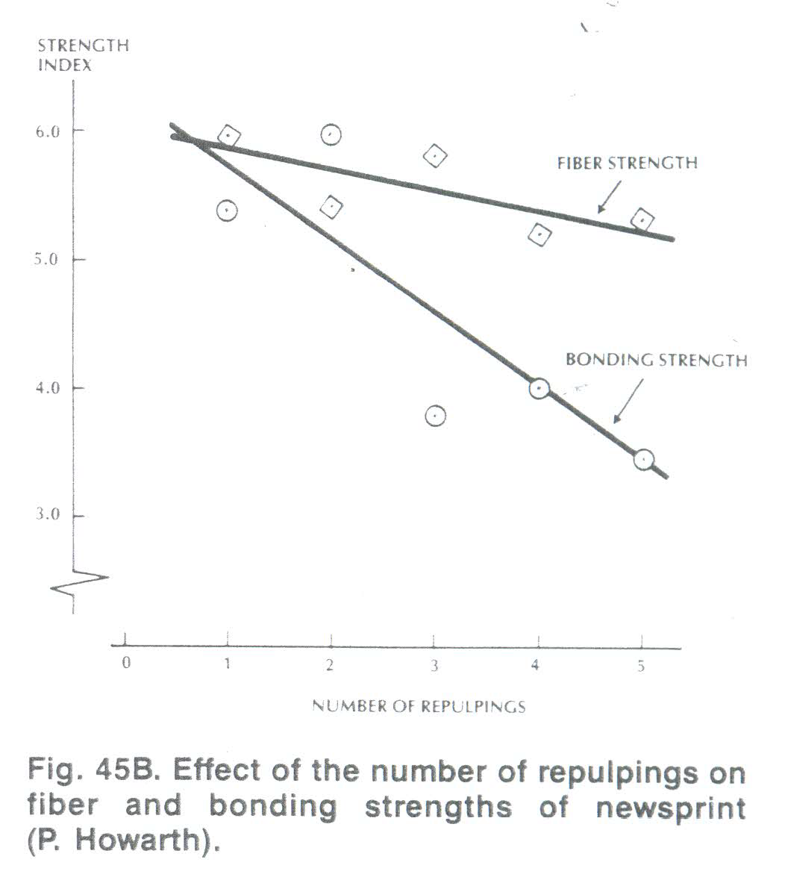

Slide 11
B.DEFINITIONS AND GRADES
Secondary fiber is not manufactured to specifications as is wood pulp which is produced from specific trees, pulping, bleaching and refining processes.
It consists of the waste from manufacturing operations such as the trim from a book, a box, a magazine, a business form or an envelope and of many grades of post-consumer waste.
Waste paper is a worldwide traded commodity with the largest source from the United States. Waste paper is traded freely across European borders except for the United Kingdom which has a unique situation and imports very little secondary fiber.

Slide 12
Several grading systems have been proposed over the years and many grades are recognized widely, but with the understanding they do not represent generic specifications.
The most widely accepted grade structure worldwide is from the Paper Stock Institute of America. Specifications generally are agreed upon between buyer and seller.
Very few grades are highly homogeneous; most are heterogeneous mixtures of various types of paper. Homogeneous grades such as newspapers, old corrugated containers (OCC) and plastic coated grades have highly specific infrastructures for collection and recycling and are preferably contracted under long-term agreements.

Slide 13
In 1931,the Waste Paper Institute was formed as a division of the National Association of Waste Material Dealers. Prior to this time, there were only 10 classifications of grades of waste paper.
Through the efforts of the Institute, 49 grades with definite specifications were established and nine of these grades are described in Table 60.
The Government's General Services Administration (GSA) in 1971 established a specification which defines secondary fiber as fibers reclaimed from solid waste or waste collected as a result of a manufacturing process , but shall not include those materials generated from and reused within a plant as part of the paper making process.

Slide 14
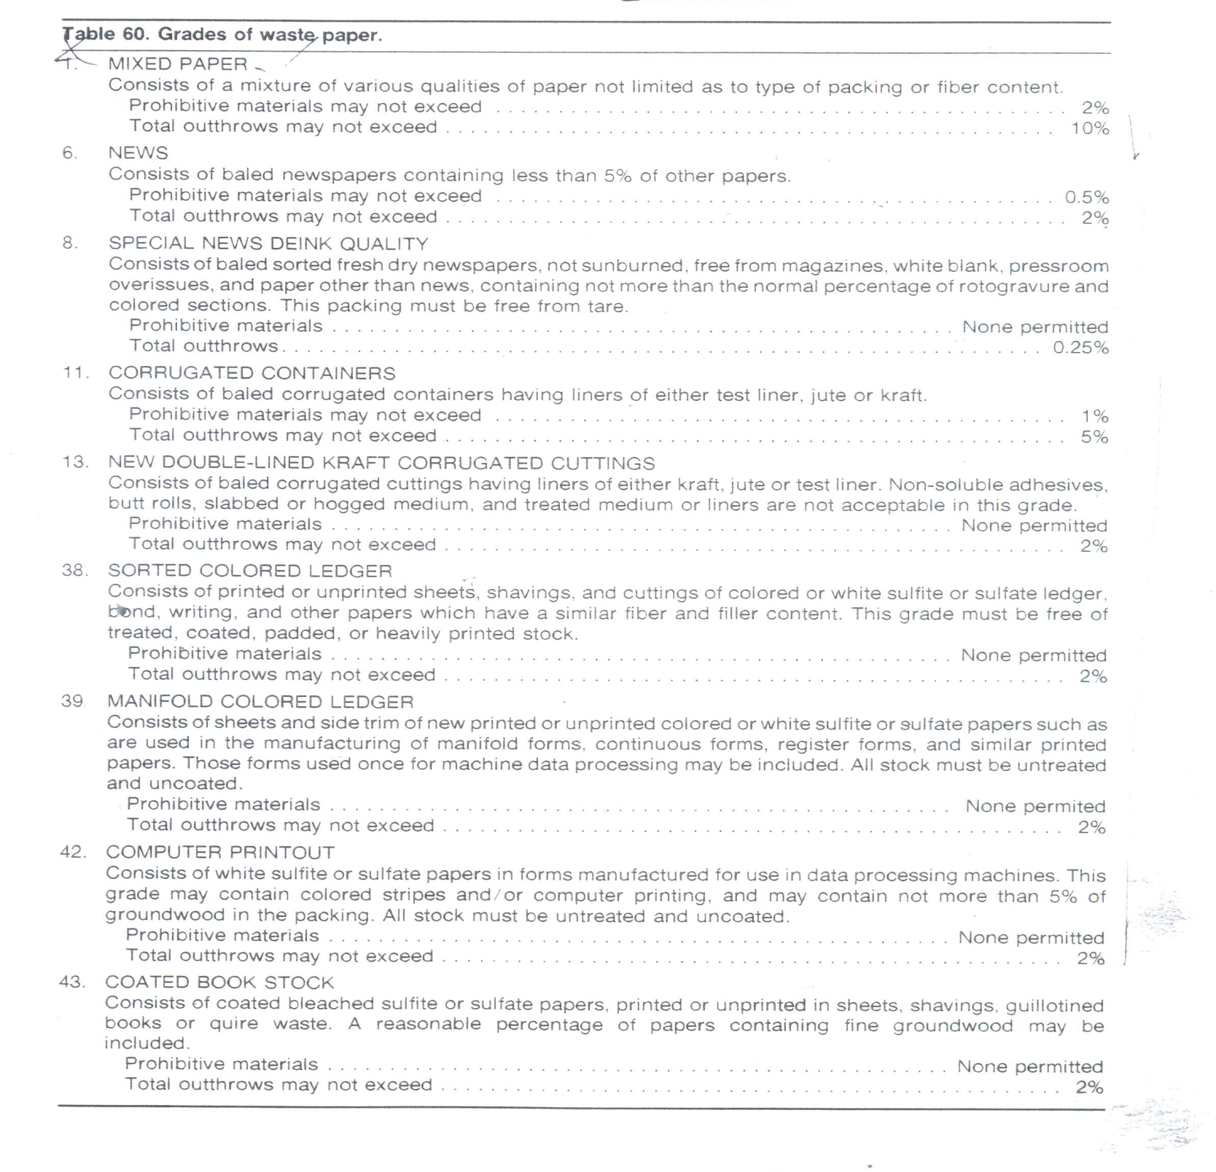

Slide 15
GSA further defines post-consumer waste as paper, paperboard, and fibrous wastes from factories, retail stores, office buildings, homes, etc. after they have passed through their end usage as a consumer item, including used corrugated boxes, old newspapers, old magazines, mixed waste paper, tabulating cards, and used cordage plus all paper, paperboard and fibrous wastes that enter and are collected from municipal solid waste.
Government specifications concerning the use of secondary fiber in paper specifications are still changing and need to be investigated specifically if the need to deal with such specifications arises.

Slide 16
C. OUTTHROWS AND PROHIBITIVE MATERIAL
Each grade is allowed a percentage of outthrows or prohibitive materials. Their definitions are as follows;
Outthrows:
The term ‘outthrows' as used throughout this section is defined as 'all papers that are so manufactured or treated or are in such a form as to be unsuitable for consumption as the grade specified'.
Prohibitive materials:
The term 'prohibitive materials‘ as used throughout this section is defined as:
a) Any materials which by their presence in a

Slide 17
packing of paper stock, in excess of the amount allowed, will make the packing unusable as the grade specified.
(b) Any materials that may be damaging to equipment.
Note: The maximum quantity of 'outthrows' indicated in connection with the following grade definitions is understood to be the TOTAL of 'outthrows' and 'prohibitive materials'.

Slide 18
D.BROAD CATEGORIES OF WASTE
The 49 grades defined by The Paper Stock Institute can be grouped into five broad categories of waste paper, as shown in Table 61.
1. Pulp substitutes
Pulp substitutes can be used as is with some limits. This type of material can be broken up in a pulper and is normally blended with other furnish to be used directly on the paper machine . Shrink values will be about 10 %.
Pulp substitutes normally consist of grades of manila tab cards(#37)*,white shavings(#27,#28,#30), envelope cuttings

Slide 19
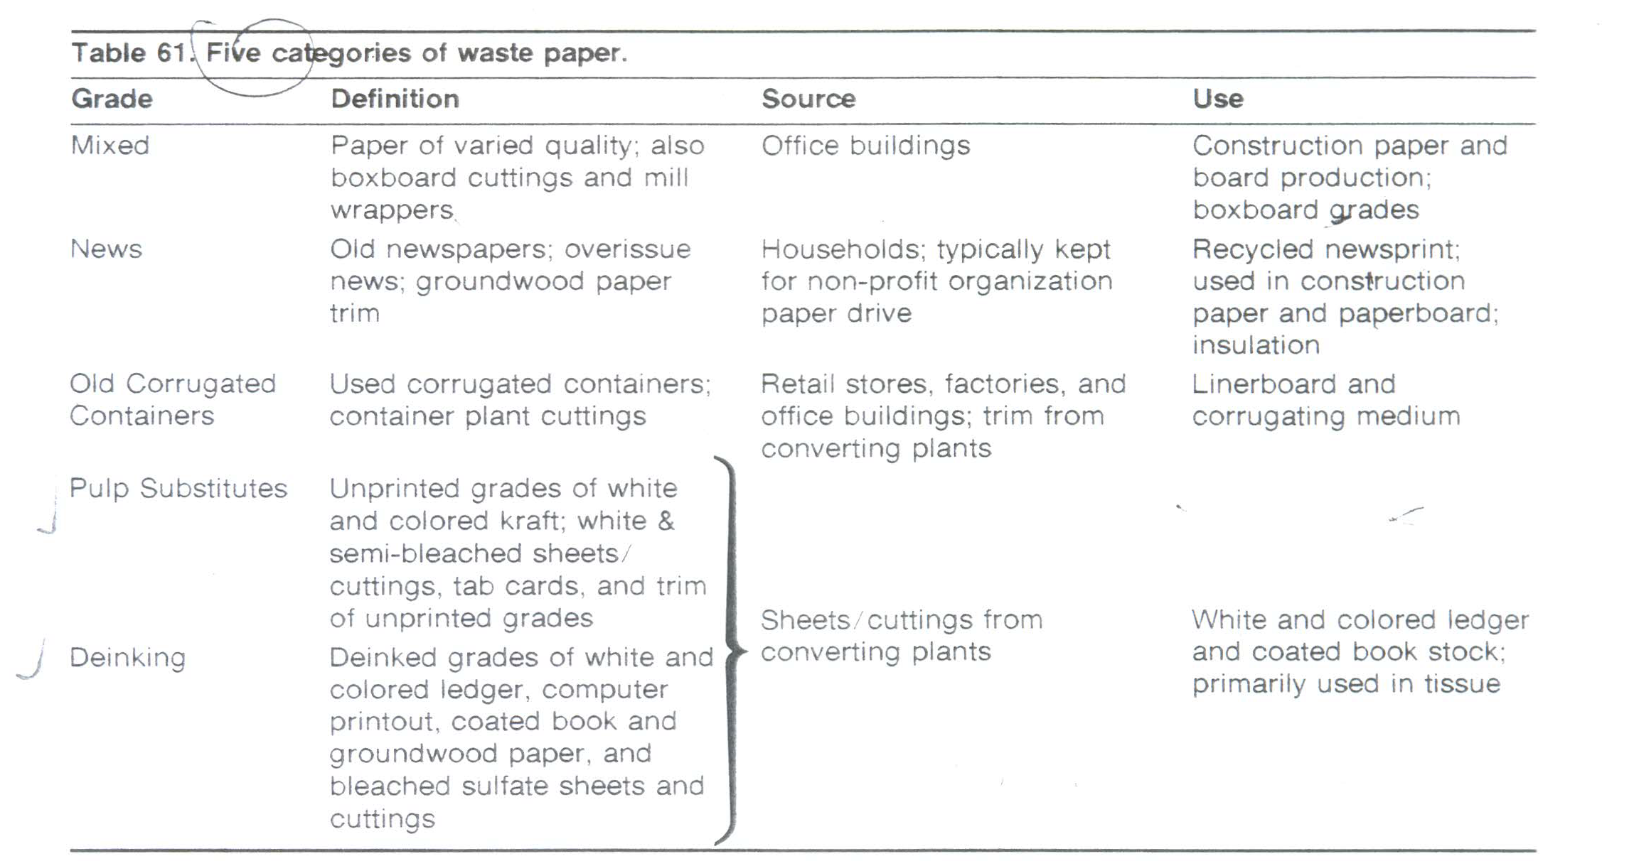

Slide 20
(#31, #33, #35), unprinted bleached sulfate (#47), side rolls and converted trim, unprinted news and groundwood (# 24, # 26), and dark kraft grades (# 15-21).
Only the white or light-colored grades are used in high grade production. These grades do not require deinking and are generally bright enough to be used simply by pulping and blending with other furnishes. The darker pulp substitutes could be utilized in dark towelling and wipes.
The problems that can be encountered, however, include wet strength which is hard to detect, very hard sheets with or without coating which do not break up easily, and heavily coated or plastic-coated sheets that are hard to detect in the bale.

Slide 21
The combination of 12-15% clay in the sheets, starch coating, or even a very light clay coating with the necessary binders may result in coating problems on the Yankee dryer that will definitely restrict the amount used. These same factors, in a closed white water system, can cause problems with felts , dryers, wires and produce slime.
In addition to normal pulp substitute categories of secondary fibers , there are furnishes that could be used either as deinking or pulp substitute grades. This would depend on the overall quality of the pack and the final product to be made.
The percentage of groundwood-containing furnish that can be used is restricted by brightness requirements.

Slide 22
Economy and increased bulk are the advantages. For example, coarse ground wood is not normally used in consumer facial and toilet tissue grades in this country.
Ledger grades which are sometimes used as pulp substitutes or for deinking include manifold colored ledger (# 39), sorted white ledger ( #40), and manifold white ledger ( #4l).
Computer printout (# 42) also fits this category. These are lightly printed and perhaps slightly colored ( # 42) but could be used in small amounts in certain grades. High yield pulps, such as mixed groundwood shavings ( #22),and white blank news (#24), are being used in increased amounts.

Slide 23
2. Deinking grades
Deinking grades of secondary fiber should be well-sorted uniform bales of graded waste paper. Deinking involves pulping, cleaning, screening and washing to remove inks, clays, soluble materials and other contaminants to produce a clean pulp which might be bleached or sent directly to the paper machine system.
Shrink values of 20-25% are normal but coated stock can increase this to 25-33%. The grades that normally require this treatment include colored tab cards (#36), white, colored and manifold ledger grades (#38-41),computer printout (#42), book stock (#43), coated groundwood (#44), and printed bleach sulfate(#45,#46).

Slide 24
The ledgers are normally in sheet form but the books, coated groundwood and some bleached kraft are appearing increasingly in the form of trim or hogged bales. The manifold ledger grades are normally clean and acceptable but high priced.
Ledger stock is becoming increasingly mixed with book. Trim stock of all grades here must be watched carefully for latex , since much of it comes from book trimmings, magazines, etc.
Coated groundwood grades, which include magazines, are supplied more now by printing houses and are generally of good quality even though most bales are hogged. Cover stock mixed in can be very bad because of plastic or UV coatings. Paperbook cover stock is not permissable in today's normal system.

Slide 25
Coated ground wood furnish can be heavily printed, meaning that a great deal of ink must be removed. Shrink will be 30-40% due to the heavy clay, ink, and fines which are washed out.
These grades are easy to deink but present higher shrink, high and variable bleach requirements, and lower final brightness.
Coated grades of all types are being used more now than in the past since they are more plentiful and normally clean.

Slide 26
The bleached sulfate (#45, #46) deinking grades have very good long fiber content, but usually have the rubber-based or more exotic plastic inks which are not removed easily in many deink plants.
They give a good deinking yield of 85-90% unless heavily coated, and a superior pulp with 85 + brightness when treated properly. They could command a high price but ineffective treatment practices have held the price down.
3. Specialty grades
These are grouped together since each one is characterized by a special property that makes it unusable in deink plants that treat

Slide 27
mixtures of furnishes. Waxes, polycoats , wet strength, glassine, hot melt, carbon paper, book stock with covers, tab cards with correction stickers, magazines with covers , carbonless ledger, and some Xerox sheets are contained in this category.
Some deinking plants can handle specialties such as polycoated stock because they are designed to do this. Most plants are not.
Specialty grades is one group, however, that will see more use as the fiber supply tightens by utilizing systems that can remove the basic contaminant.

Slide 28
4. Low quality grades
Post-consumer grades of mixed paper (#2) and super mixed paper (#3) are not normally used as furnish in deinking operations.
Good mixed grades come from office waste and industrial waste, and could also come from the sorting of higher grades.

